Slide 1
How to set up an integration and import records with OCLC Connexion
Yoel Kortick
Senior Librarian
October 2024

Slide 2
Agenda
Introduction
Configuring an Integration Profile of type OCLC Connexion
Configuring the OCLC Connexion client
Exporting a record from OCLC Connexion into Alma
2

Slide 3
Introduction

Slide 4
Introduction
In addition to this presentation, it is recommended to also see Importing Records from OCLC Connexion / Record Manager
While the information shown in this presentation relates to OCLC Connexion, it also applies for OCLC Record manager
We will be showing, as the title of this presentation suggests, the setup and workflow in OCLC Connexion.
  Note that it is also possible to import records from OCLC by using an external search profile. For more information see Configuring External Resources for Searching and Working with Search Resources in the MD Editor
In this presentation we will be using "Connexion client 3.1" downloaded from https://help.oclc.org/Librarian_Toolbox/Software_downloads/Download_cataloging_software#Connexion_client_3.1

Slide 5
Introduction
Note that we will not be doing a "deep dive" into using the OCLC Connexion client.
Our goal here is to set up both Alma and the OCLC Connexion Client to "work together" such that a record can be searched for and found via the OCLC Connexion Client and then exported from the OCLC Connection Client and imported into Alma.

Slide 6
Configuring an Integration Profile of type
OCLC Connexion

Slide 7
Configuring an Integration Profile of type OCLC Connexion
See also: Configuring the Integration Profile for OCLC Connexion
Before installing and configuring the OCLC Connexion client an Integration Profile of type "OCLC Connexion" needs to be set up in Alma.
Access the Integration Profiles at "Configuration > General > External Systems > Integration Profiles"
Before creating an Integration Profile of type "OCLC Connexion" it is recommended to see if one already exists. Only one Integration Profile of type OCLC Connexion needs to exist, regardless of how many staff users will be using OCLC Connexion.

Slide 8
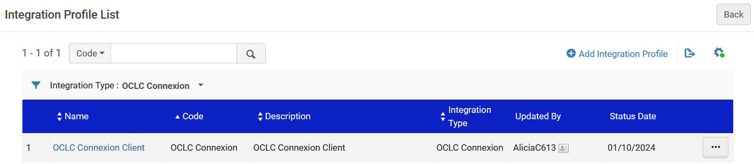
Configuring an Integration Profile of type OCLC Connexion
Here we have filtered the Integration Profiles by type "OCLC Connexion" and see that one already exists:

Slide 9
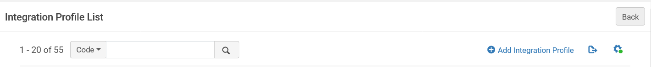
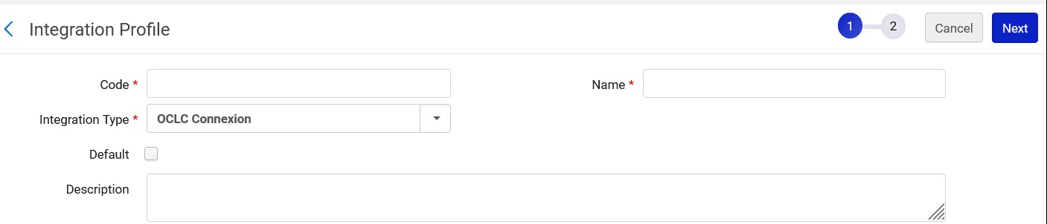
Configuring an Integration Profile of type OCLC Connexion
If an Integration Profile of type "OCLC Connexion" did not already exist, then from the "Integration Profile List" we could click "Add Integration Profile" and choose "Integration Type" as "OCLC Connexion":

Slide 10
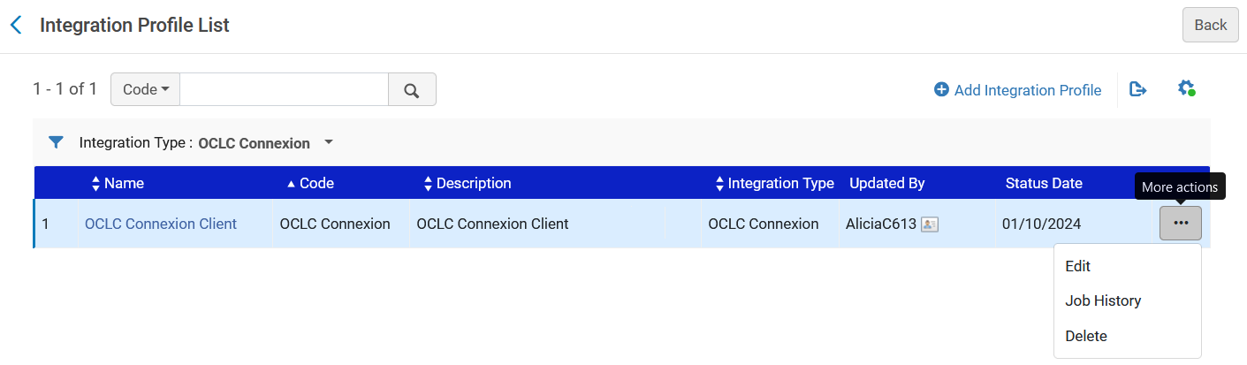
Configuring an Integration Profile of type OCLC Connexion
We will edit our existing Integration Profile of type "OCLC Connexion" in order to see how it is configured.

Slide 11
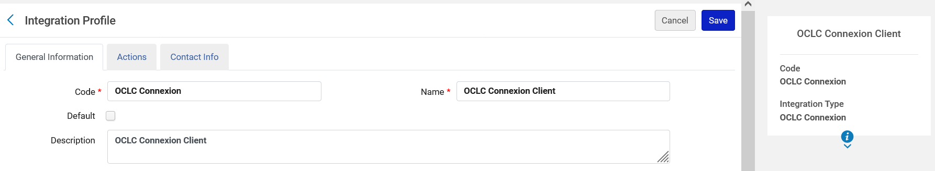
Configuring an Integration Profile of type OCLC Connexion
Here is the "General Information" tab.
The "Code" and "Name" can be any value, but it recommended to make it something relevant.
The "Integration Type", as already stated, is determined when creating the Integration Profile.
The "Default" checkbox is irrelevant.
The "Description" field is free text and can be whatever the institution wants to put there.

Slide 12
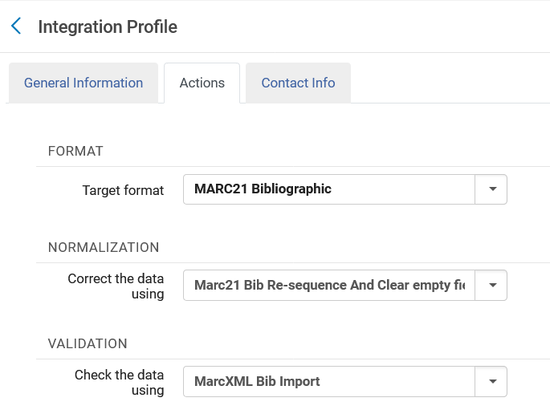
Configuring an Integration Profile of type OCLC Connexion
Here are the "Format", "Normalization" and "Validation" sections of the "Actions" tab.
The "Target format" is the record format in which the records will be imported to and stored in Alma
The "Correct the data using" is the normalization processes which will be run on the records as they are imported to Alma (For more information, see Working with Normalization Processes).
The "check the data using" is the method to handle invalid data as it is being imported (For more information, see Working with Validation Exception Profiles). For Integration Profiles, Ex Libris recommends using the "MarcXML Bib Import" validation exception profile.

Slide 13
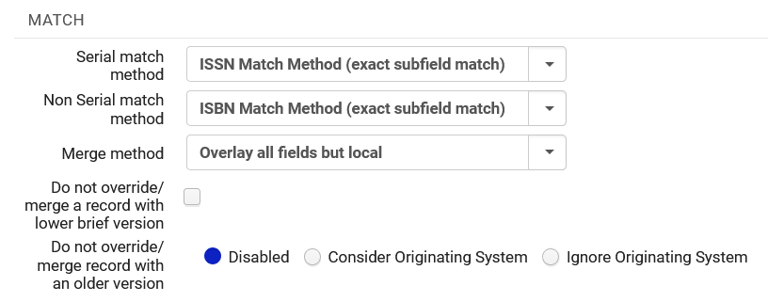
Configuring an Integration Profile of type OCLC Connexion
Here is the "Match" section of the "Actions" tab.
Here we can determine if the record we are importing already exists in Alma, and if so what to do.
These are the same fields used in other places in Alma, such as in Import profiles.
For details see "OCLC Connexion Profile Fields" at Configuring the Integration Profile for OCLC Connexion.

Slide 14
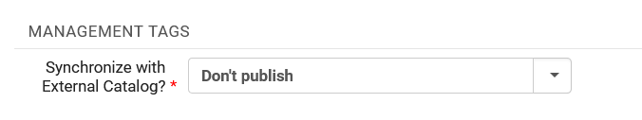
Configuring an Integration Profile of type OCLC Connexion
Here is the "Management Tags" section of the "Actions" tab.
The pull-down options here for "Synchronize with External Catalog" are the same fields which appear in the Metadata Editor via "Record Actions > Set management Tags" and also appear in Import Profiles.
It determines if and how imported records will be synchronized with external catalogs.
See "Set Management Tags" at Working with Records.

Slide 15
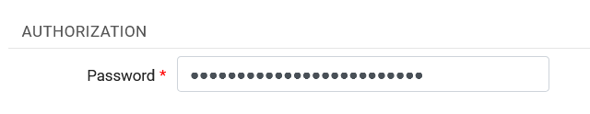
Configuring an Integration Profile of type OCLC Connexion
Here is the "Authorization" section of the "Actions" tab.
The password defined here is the same password which will later be defined in the OCLC Connexion Client when configuring the OCLC Connexion client (we will see this together soon).
This is a password controlled by each Alma institution and used by the OCLC Connexion/Record Manager client to connect to Alma. It must be at least 10 characters.

Slide 16
Configuring the OCLC Connexion client

Slide 17
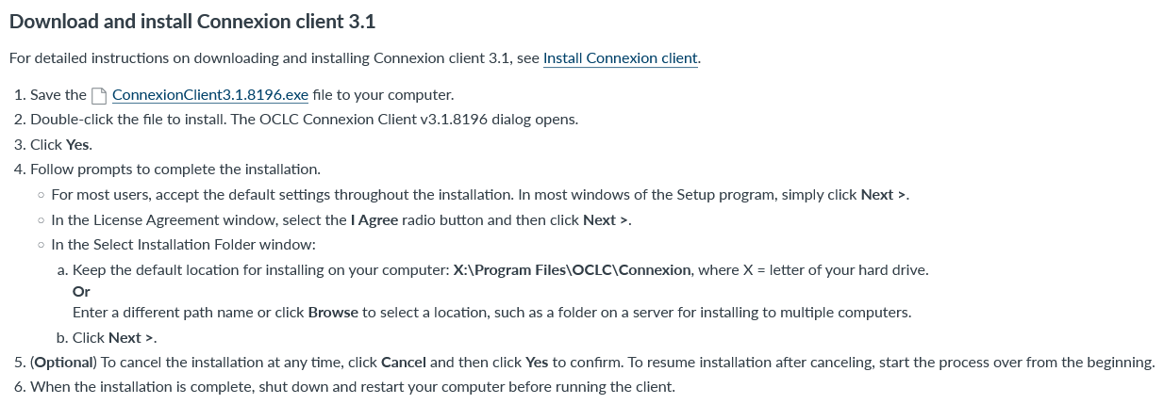
Configuring the OCLC Connexion client
As previously stated in the introduction, in this presentation we will be using "Connexion client 3.1" downloaded from https://help.oclc.org/Librarian_Toolbox/Software_downloads/Download_cataloging_software#Connexion_client_3.1

Slide 18
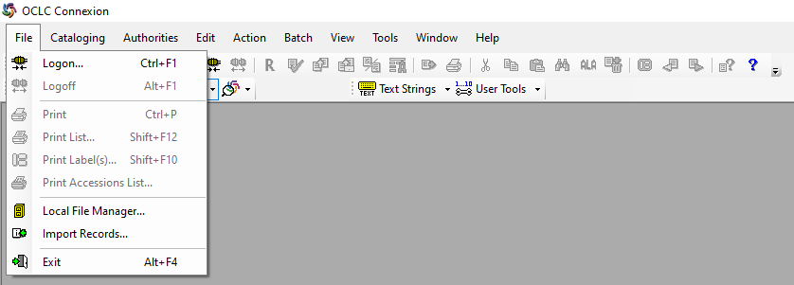
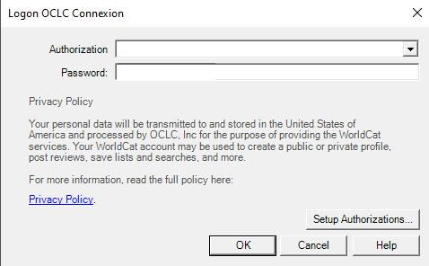
Configuring the OCLC Connexion client
Step one: In the OCLC Connexion client choose "File > Logon" and then click "Setup Authorizations"

Slide 19
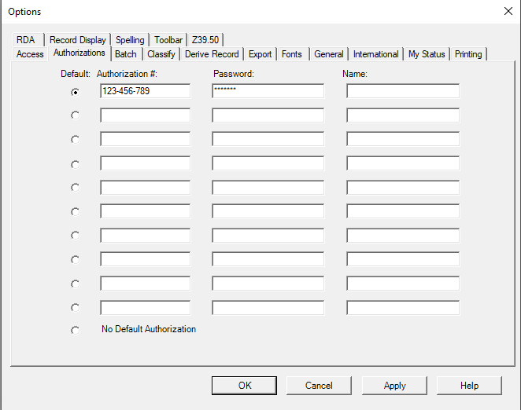
Configuring the OCLC Connexion client
Step two: In the "Authorizations" tab of the "Options" window enter the Authorization and Password (from OCLC) and click "OK"

Slide 20
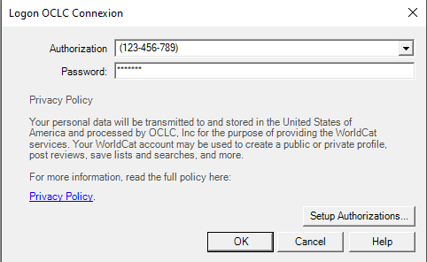
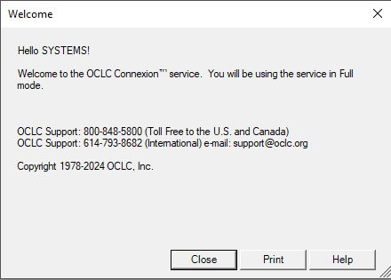
Configuring the OCLC Connexion client
Step three: Click "OK" again and then "Close" to confirm

Slide 21
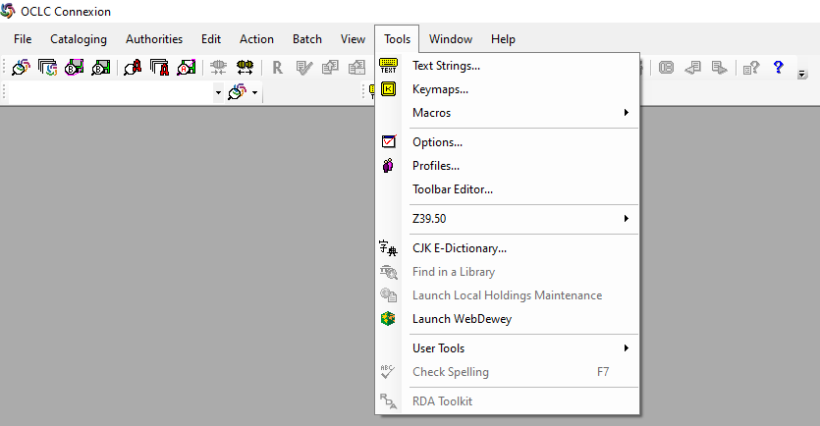
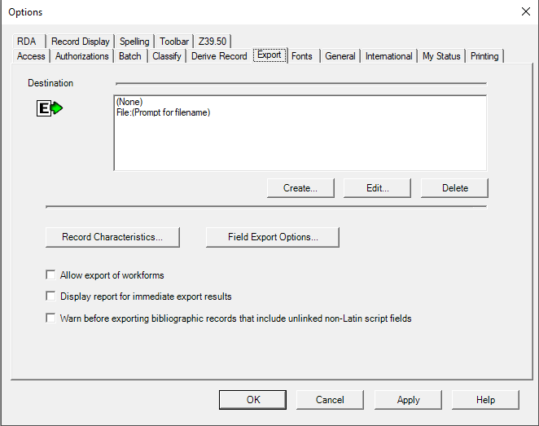
Configuring the OCLC Connexion client
Step four: Do "Tools > Options" and go to tab "Export" and click "Create"

Slide 22
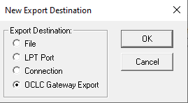
Configuring the OCLC Connexion client
Step five: In the "New Export Destination" window choose "OCLC Gateway Export" and click OK

Slide 23


Configuring the OCLC Connexion client
Step six (part one of three): Fill in the "OCLC Gateway Export – Local System Settings" as follows:
  Host Name: {Your Instance}.alma.exlibrisgroup.com. For example:
    If your instance is eu00 then your Host Name will be eu00.alma.exlibrisgroup.com
    If your instance is na02 then your Host Name will be na02.alma.exlibrisgroup.com
    If you do not know your instance, then click the question mark on the top right of Alma and see the instance name on the bottom

Slide 24
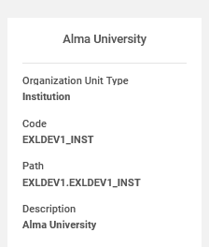
Configuring the OCLC Connexion client
Step six (part two of three): Fill in the "OCLC Gateway Export – Local System Settings" as follows:
  Port: 5500
  Check the box "Send local system login id and password"
  Logon ID: The institution code
    If you do not know your institution code do "Configuration > General > Libraries > Add a Library or Edit Library Information" and see the Institution Code

Slide 25
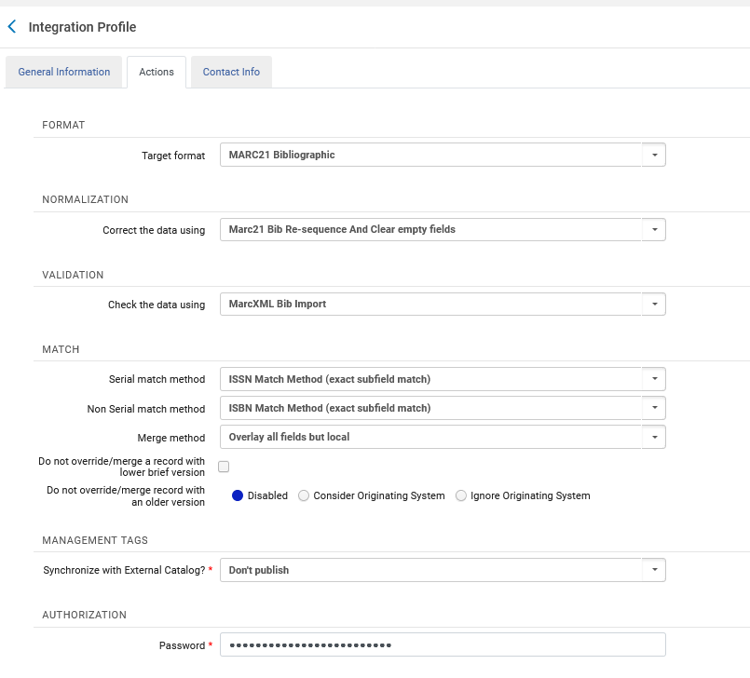
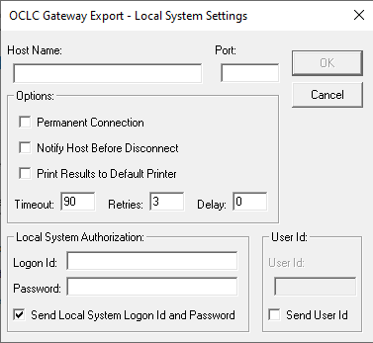
Configuring the OCLC Connexion client
Step six (part three of three): Fill in the "OCLC Gateway Export – Local System Settings" as follows:
  Password
    It should be the same as the password entered in the Alma Integration Profile of type "OCLC Connexion" in the "Authorization" section
These should be the same

Slide 26
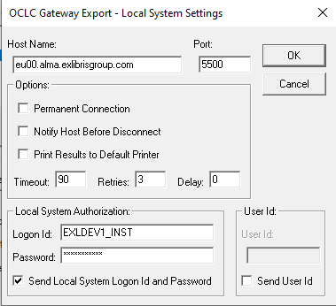
Configuring the OCLC Connexion client
Step six : Here is the "OCLC Gateway Export – Local System Settings" for our example
Click OK when done

Slide 27
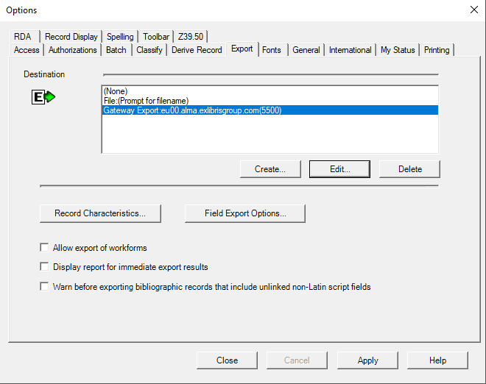
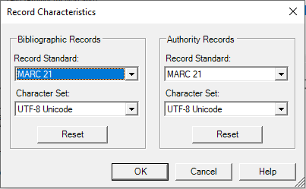
Configuring the OCLC Connexion client
Step seven : Click button "Record Characteristics" and make the "Character Set" have encoding UTF-8 (this is not mandatory but is recommended)
Click OK when done

Slide 28
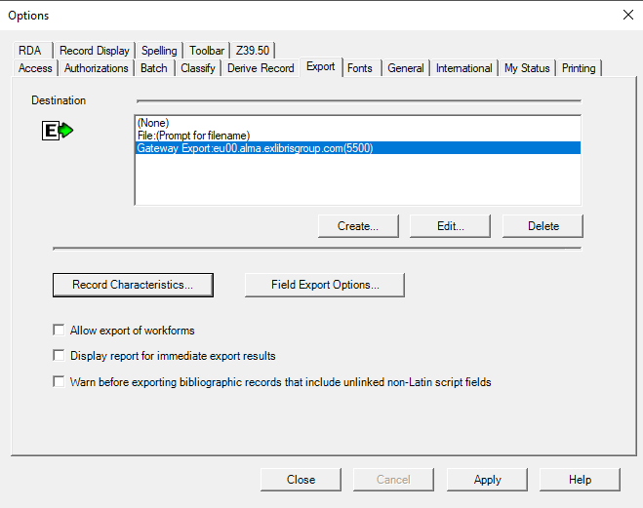
Configuring the OCLC Connexion client
Step eight : Close the "Options" window

Slide 29
Exporting a record from OCLC Connexion into Alma

Slide 30
Exporting a record from OCLC Connexion into Alma
In the example here we will search OCLC Connexion for title "The history of the state of Ohio" published in 1875, and then we will export it from OCLC Connexion into Alma.
There are multiple ways this can be done in the OCLC Connexion client, and we will show just one way.
Note that what happens to the record inside Alma depends on the definitions in the Alma Integration profile of type "OCLC Connexion", particularly those in the "Match" section.

Slide 31
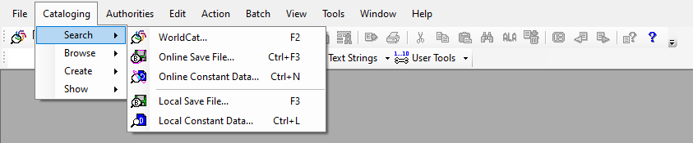
Exporting a record from OCLC Connexion into Alma
Step one: Choose "Cataloging > Search > WorldCat" (or do F2 or click the CatalogingSearchWorldCat icon on the top)

Slide 32
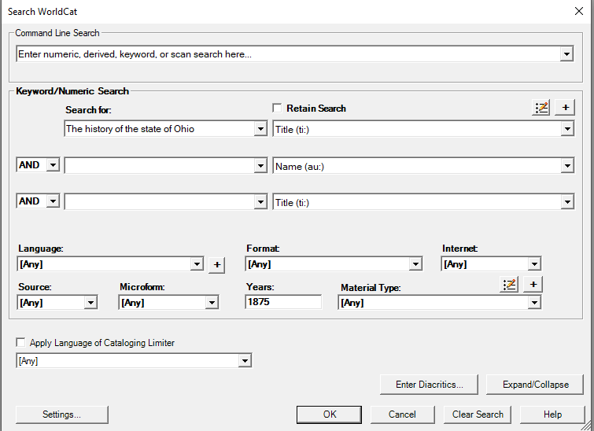
Exporting a record from OCLC Connexion into Alma
Step two: Enter search criteria and click OK

Slide 33
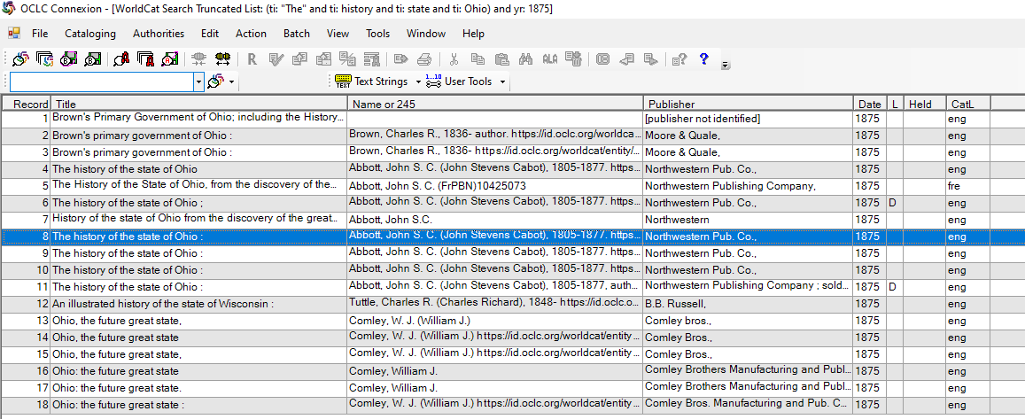
Exporting a record from OCLC Connexion into Alma
Step three: Double click one of the results
We will double click here

Slide 34
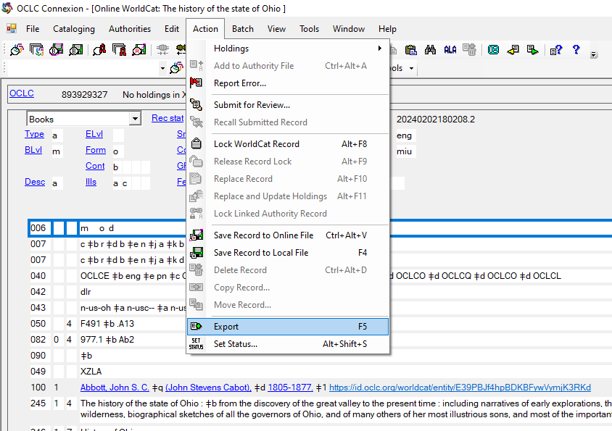
Exporting a record from OCLC Connexion into Alma
Step four: Choose "Action > Export" (or do F5 or click the ActionExport icon the top)

Slide 35
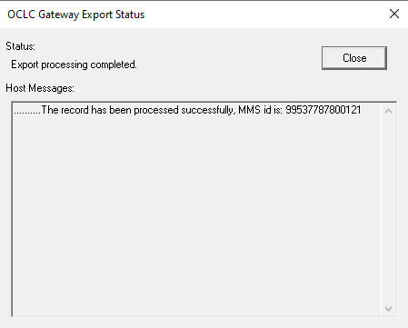
Exporting a record from OCLC Connexion into Alma
Step five: Receive information on the exported record via the "OCLC Gateway Export Status" window, for example the Alma MMSID of the exported record. Close the window.
We will go see the record in Alma

Slide 36
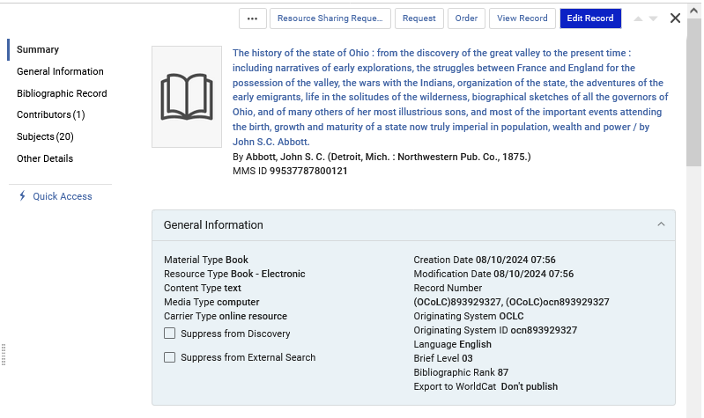
Exporting a record from OCLC Connexion into Alma
Here is the record in Alma

